Slide 1
Latency Counting in the SUS Language
Lennart Van Hirtum
PC2 - Paderborn University
Prof. Christian Plessl
PC2 - Paderborn University
LATTE’24
Notes:
SUS is a language that focusses on making RTL design easier, but not necessarily on making incorrect hardware irrepresentable. The main idea is if we make it easy enough for the user to use the correct abstraction, then won’t
SUS Goals
No time for whole language
Pick out Latency counting interesting
Not incorrect unrepresentable, but correct easy
mental model
Hi, I’ll talk today on what the goals are for the latency counting system in the SUS Hardware Design language. I won’t have time to go into the details on the whole language here, so I picked out this system as it’s the most interesting.
The goal with SUS is not to make incorrect hardware unrepresentable, but to make creating correct hardware easier than incorrect by mapping the language more closely to the hardware designer’s mental model.

Slide 2


Registers
LATTE’24
Notes:
State & Latency regs
Distinction is intention
State: clock cycles in logic function
Latency: pipelining/meeting timing
SUS creates a major abstraction by dividing the registers in two categories. State and latency registers. The distinction is programmer intention:
State registers are for when you want to move data across clock cycles as part of the logic’s function.
Latency registers are purely for pipelining and meeting timing. In the rest of the slides, state registers are blue, and latency registers yellow.

Slide 3
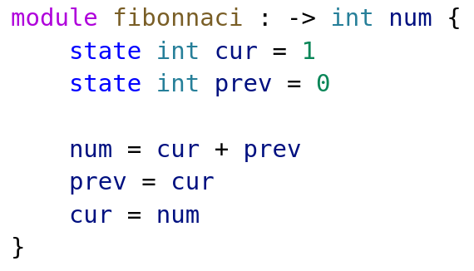
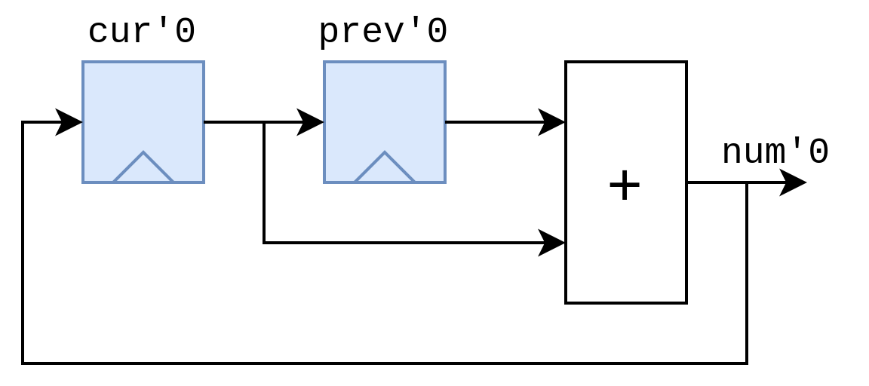
State registers
LATTE’24
Notes:
Just state, same as normal
one elem per clock
explicit use of regs in logic
Here is a small example of just state registers. State registers are exactly the same as you would find in other HDLs like Verilog or VHDL.
This fibonacci module generates the sequence one element per clock cycle.
In this example we explicitly want to move data across clock cycles as part of the design’s functioning.

Slide 4
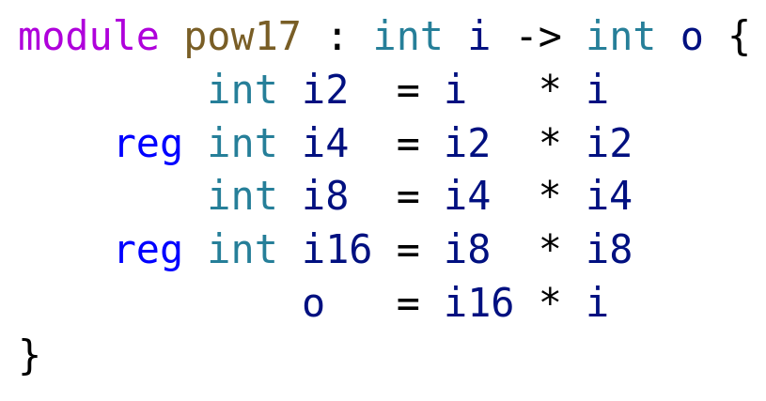
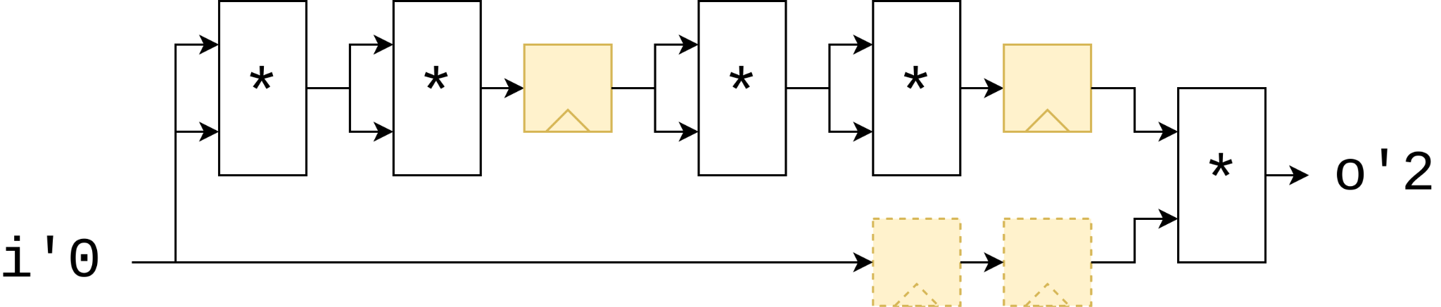
Latency Registers
LATTE’24
Notes:
Latency used timing
Not allowed to affect functionality
17th pow i
i*i 4 times
multiply by original
add latency on one branch, compiler adds to sync
Most languages support this
Latency registers on the other hand, are exclusively used to meet timing. They are not allowed to affect the functionality of the design. (aside from the added latency of course).
In this case, we have a module that computes the 17th power of i. It multiplies i with itself four times, and then multiplies the original with that. We add some latency registers here and the compiler automatically adds extra registers to keep everything in sync.
It is implemented by keeping track of a value called “absolute latency”, which is increased for every latency register the code passes. That’s the number after the quote.
So far so good, this is a feature most pipeline design languages support.

Slide 5
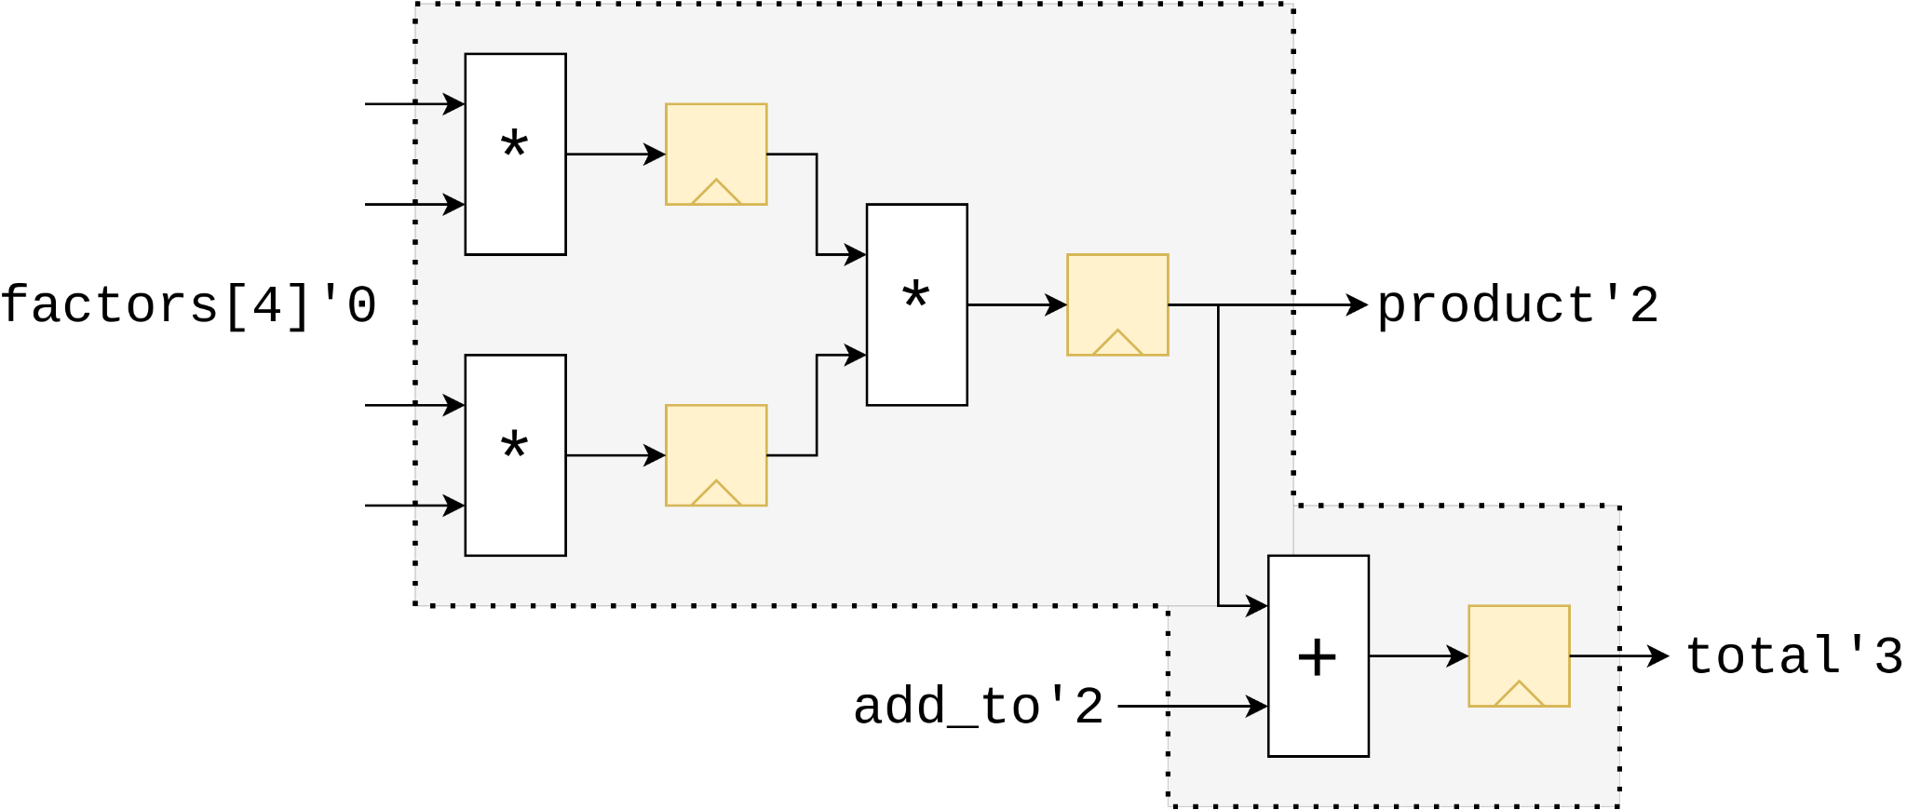
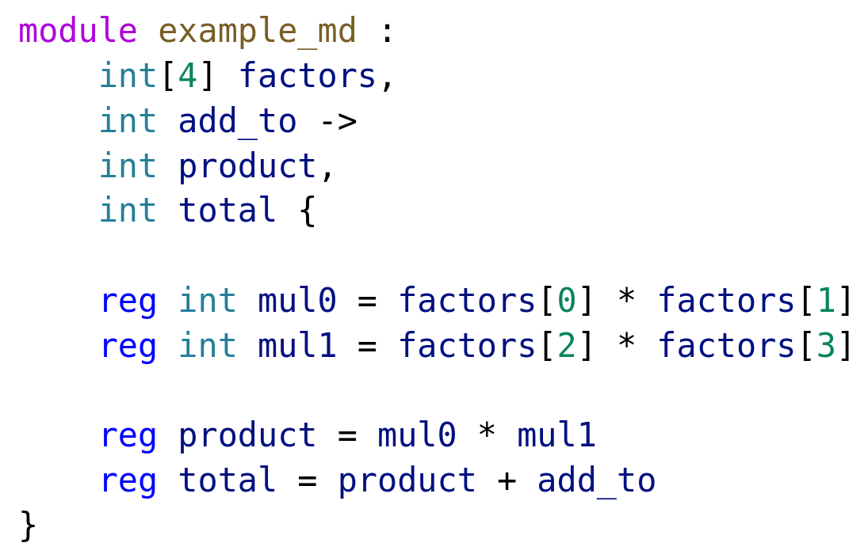
Port Latencies
Notes:
Design freedom -> ports differ latencies
factor list is 0, add_to 2 and so on
differences in port latencies used for counting for modules using it
latencies don’t need be specified, Latency Count infers them
inference makes latency count not as trivial as at a glance
To allow as much design freedom as possible, SUS allows ports to be at different latencies. For example in this case the factors list is at Absolute Latency 0, add_to 2, and so on. When the module is instantiated the port latencies are used in the parent module.
These latencies don’t need to be specified, as a big part of Latency Counting is inference of them. But this inference makes latency counting not as trivial of a problem as it might seem at first glance. What is important to see here is that any module has only one correct canonical representation.

Slide 6
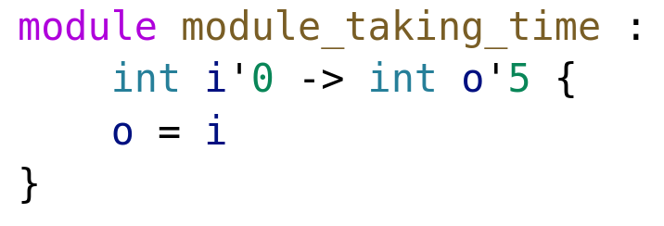
Latency Annotations
LATTE’24
Notes:
Possible to override inferred
Forced to instantiate 5
ordinarily wire
It is however possible to override the inferred latencies with custom ones, as in this example. Here it is forced to instantiate 5 registers, where it would have ordinarily been a wire.

Slide 7
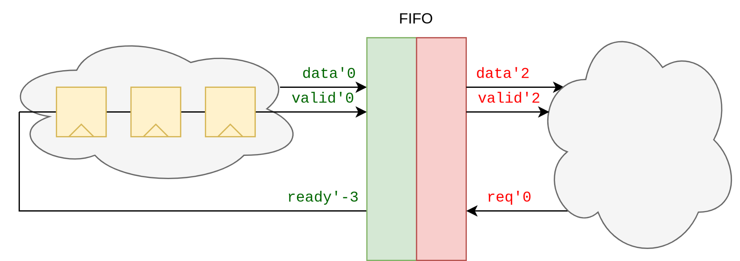
Multiple Interfaces
LATTE’24
Notes:
Multiple interfaces
Each has latency “origin”
Interfaces are independent
Ports on write are “correlated”, no direct connection to read side
Modules can have multiple interfaces, each of which has its own latency ‘origin’. Interfaces are independent. Like in this example, all ports on the write side of the fifo are “correlated”, but they don’t have a direct connection to the ports in the read side.

Slide 8
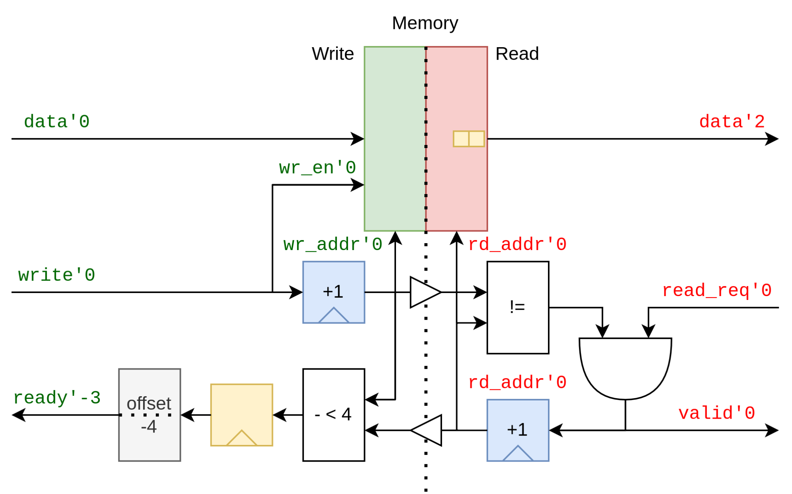
Latency Cuts
LATTE’24
Notes:
FIFO Impl
Can see two interfaces
barrier shown triangles
no latency info carried
allow slack for user code
more interesting things:
added latency shows possible to combine
offset by -4 to allow write slack
crossing and offset are “breaking out”
Similar to Clock Domain Crossing - SUS way of CDC
Diving into the FIFO implementation, we can distinctly see the two interfaces. When crossing an interface barrier, as shown with the white triangles, no latency information is carried over.
This FIFO allows for four cycles of delay between the ready and write ports, to allows some slack for the data provider’s implementation.
There’s several more interesting things in this image. For example we added a latency stage to the ready port, because this comparison could be expensive. Crossing the interface barrier is kind of breaking out of the latency counting system though, as is the offset -4 block.
Finally you can notice that this is very similar to a clock domain crossing. In fact, interfaces are the place where clock domain crossings are done in SUS.

Slide 9
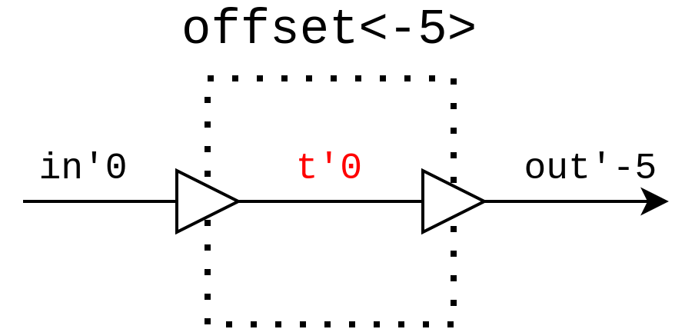
Latency offsets
Notes:
Offset impl using latency cuts
anonymous interface
As an aside, it’s actually possible to implement latency offsets using only latency cuts. Simply pass the data through an anonymous interface and back.

Slide 10

github.com/pc2/sus-compiler
LATTE’24
Notes:
thank
LC small part of SUS
more to discuss, all I have time
such as inferring submodule latencies
Right then, I hope you all enjoyed my talk. Of course latency counting is only a small part of the SUS compiler, and there’s much much more to discuss, but this is all I have time for.

Slide 11
SUS Goals
Control
Simplicity
Feedback
Notes:
“No spooky action at a distance”
“No implementation Mystery”
Simplicity:
Simple syntax
Conceptual
What to infer, and how much
Feedback:
Error Reporting

Slide 12
Latency Counting

Slide 13



Control
Simplicity
Feedback

Slide 14
Control
All register-based hardware representable
What you write is what you get
Notes:
“No spooky action at a distance”
“No implementation Mystery”

Slide 15
Simplicity
Conceptual
Syntactic
Edit Simplicity
When to infer things?

Slide 16

Designer Feedback
LSP
Code Navigation
Instant In-Editor Feedback
No compile step

